Slide 1
LESSON 4.3
Covalent Network Structures

Slide 2
LESSON GOALS
I can explain the properties of covalent network structures in terms of their structures

Slide 3
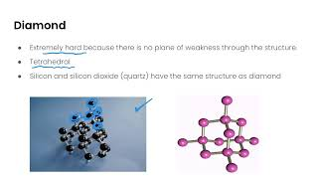
TASK 1: LEARN (MUST DO)
Individually or with a partner:
Watch the Giant Covalent Compounds (this is another name for Covalent Network Structures) video
Take some notes for yourself

Slide 4
TASK 2: PRACTICE (MUST DO)
Individually or with a partner:
Read your textbook, pg. 135 - 137
Complete the covalent network structures summary chart
Also, why are silicon-silicon bonds generally weaker than carbon-carbon bonds? Discuss with a partner!

Slide 5
TASK 3: PRACTICE
Complete the Covalent Network Structures Practice (answers included)
Note: There are must do, should do, and aspire to do questions included in this practice!

Slide 6
TASK 4: MASTERY CHECK (MUST DO)
Individually:
Complete the covalent network structures mastery check (posted in Brightspace under Quizzes!)

